Slide 1
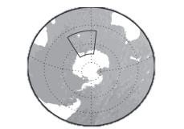
Kerguelen Is.
0º
180º
Northern Kerguelen
Heard Is.
FTC
Chun Spur
Faun Trough
Elan Bank
Banzare
Bank
Southern Kerguelen
SACCF
SB
Princess
Elizabeth
Trough
ASF
Prydz Bay
East Antarctica

